Slide 1



Hanover and Tyke
Home
Service
About Us
Contact
Coffee
www.reallygreatsite.com

Slide 2

Hanover and Tyke
Problem Statement
The project focuses on analyzing coffee shop sales data using SQL to uncover key insights. The tasks include transforming transaction dates and times, calculating total sales, and evaluating month-over-month changes. Additionally, the analysis covers sales by location, product category, and time, identifying top products and peak performance periods. The goal is to extract actionable insights to enhance sales strategies and operational efficiency.

Slide 3
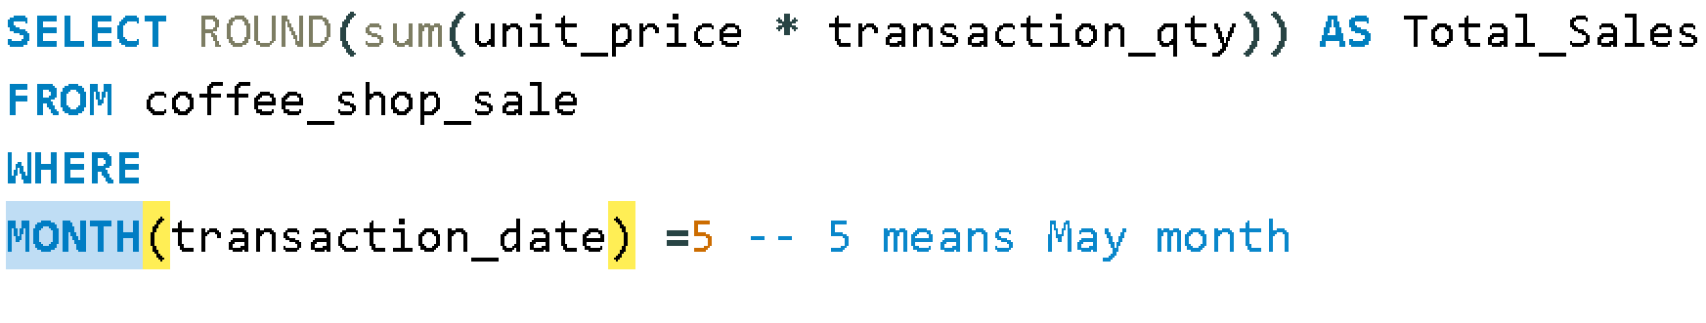
Hanover and Tyke
WRITE QUERY TO FIND SALE FOR MAY MONTH

Slide 4
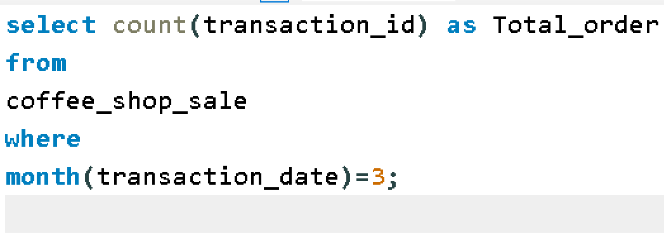
Hanover and Tyke
Calculate total number of order for each march month

Slide 5
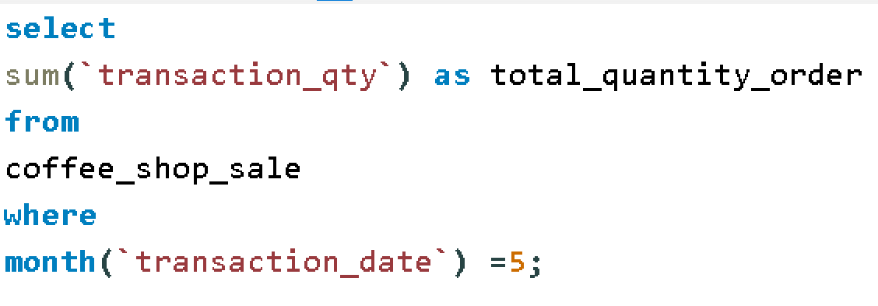
Hanover and Tyke
Calculate total quantity for may month

Slide 6
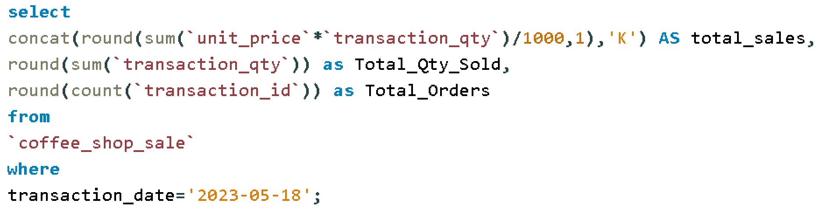
Hanover and Tyke
Calculate total_sales,Toatal_qty-sold,total order for particular day

Slide 7
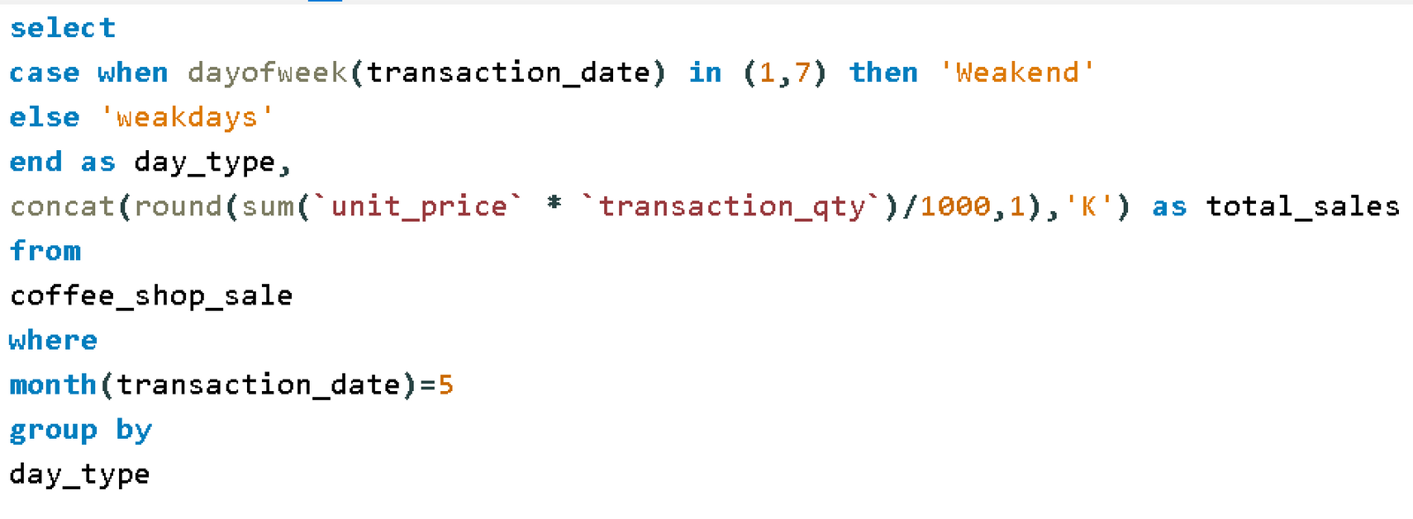
Hanover and Tyke
Calculate total sale for weakdays and weakend in may month

Slide 8
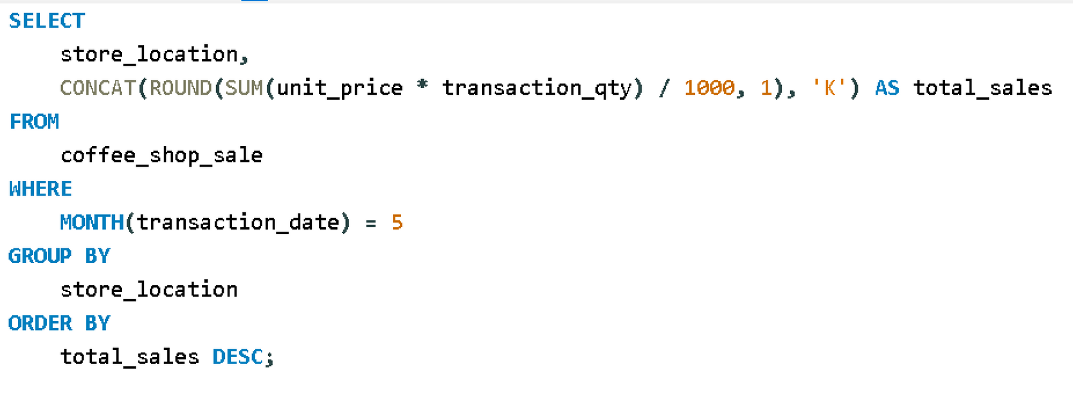
Hanover and Tyke
Calculate total sale by location for may month

Slide 9
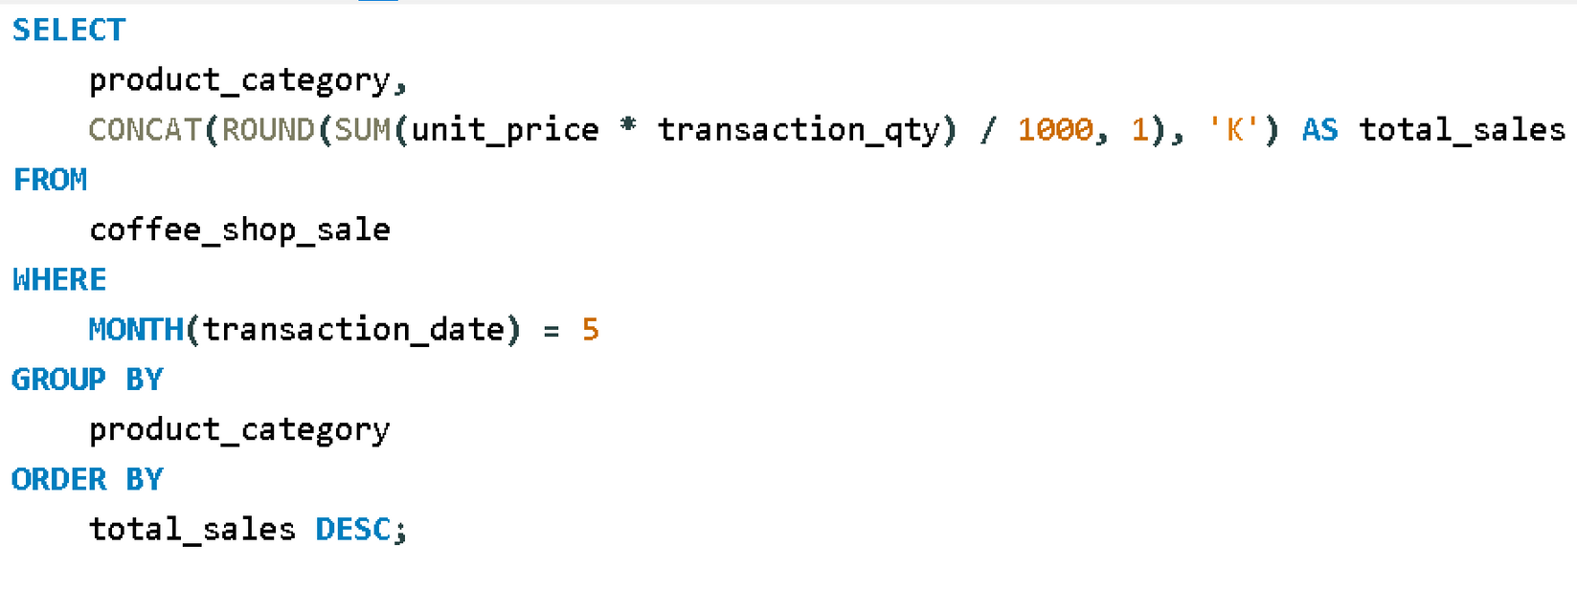
Hanover and Tyke
Calculate total sale by product_category for may month

Slide 10
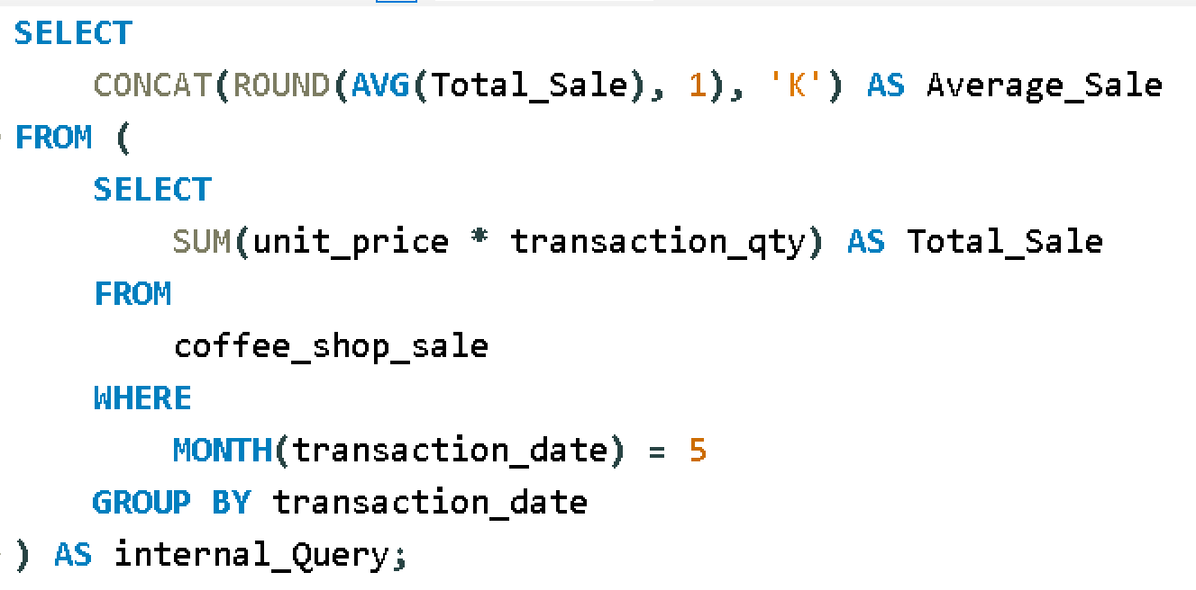
Hanover and Tyke
Find average monthly sale for may month

Slide 11
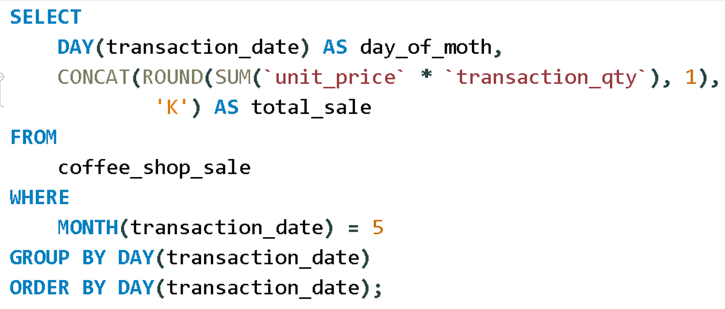
Hanover and Tyke
Find average daily sale for may month

Slide 12
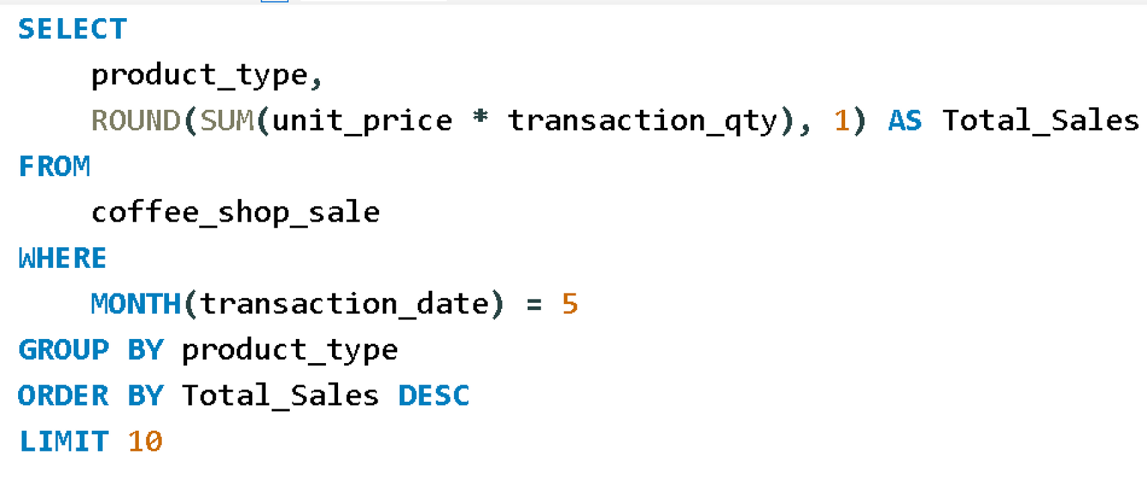
Hanover and Tyke
Determine top 10 product for may month

Slide 13
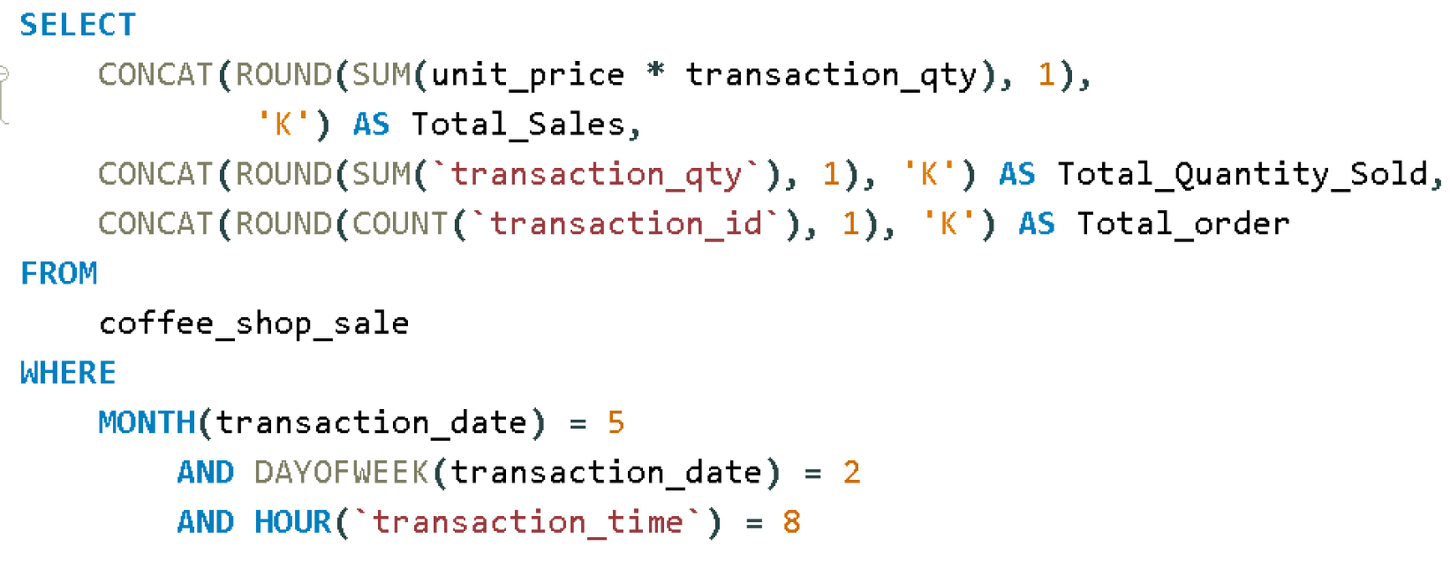
Hanover and Tyke
Calculate total_sale,Total_qty_sold,Total_order when Month=May,Day=Monday,Hour=8

Slide 14
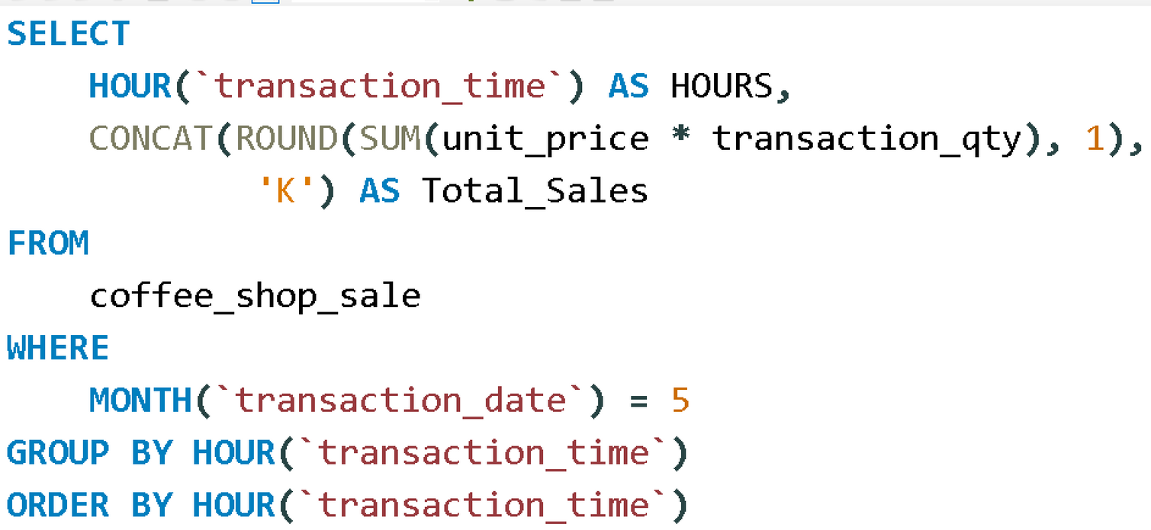
Hanover and Tyke
WRITE QUERY TO GET SALES FOR ALL HOURS FOR MONTH OF MAY

Slide 15
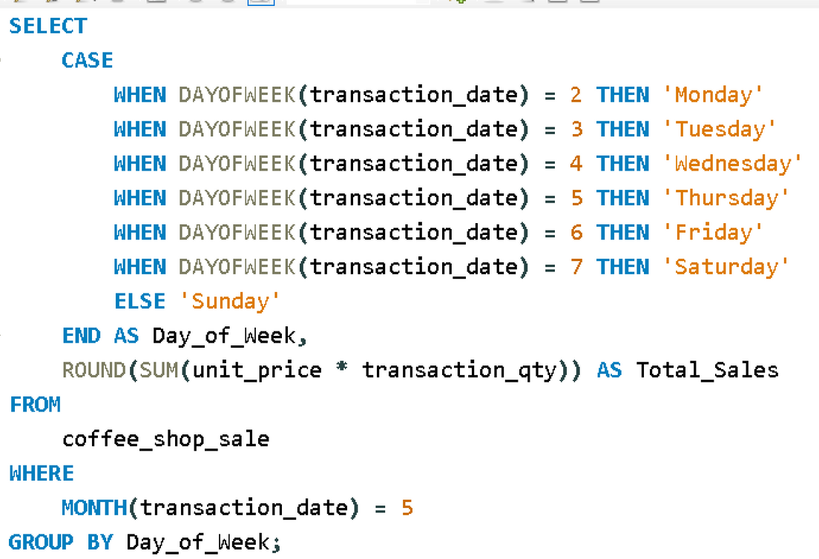
Hanover and Tyke
Write Query TO GET SALES FROM MONDAY TO SUNDAY FOR MONTH OF MAY

Slide 16
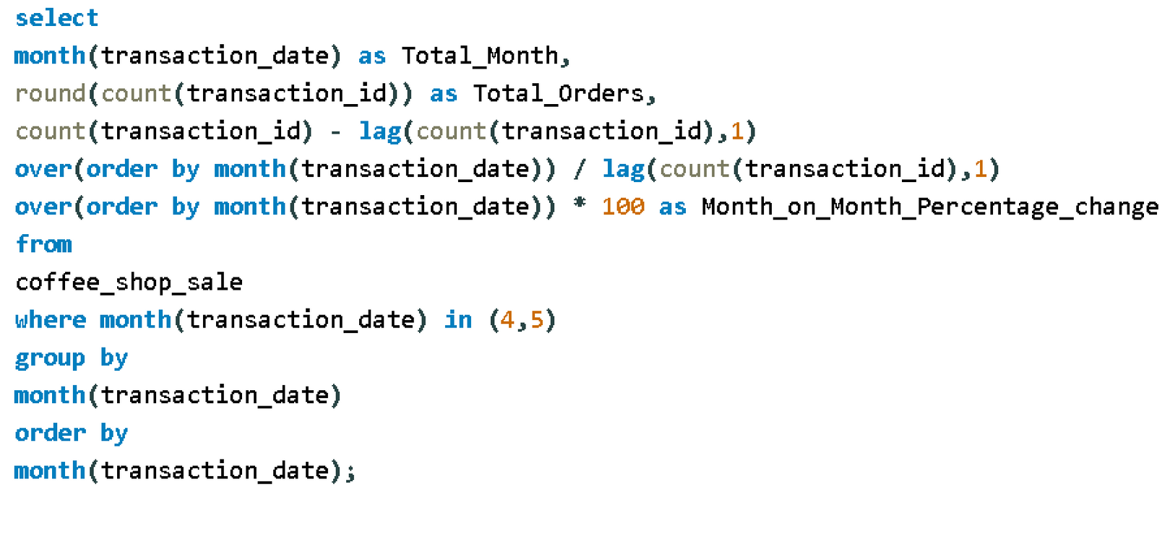
Hanover and Tyke
Determine the month on month increase or decrease in total number of order?

Slide 17
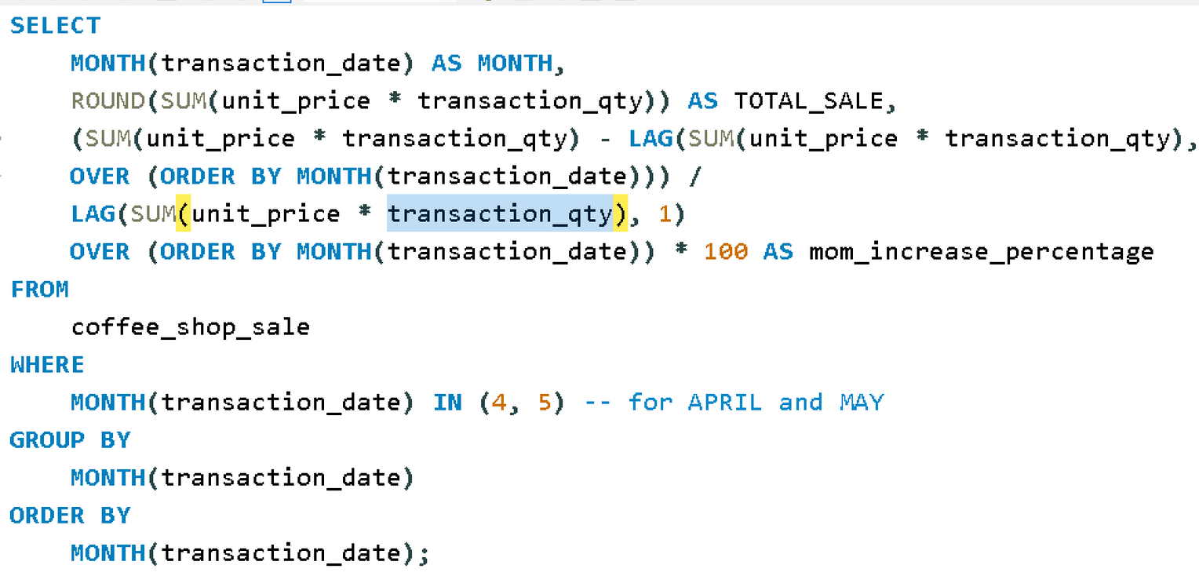
Hanover and Tyke
Determine the month on month increase or decrease in sale

Slide 18
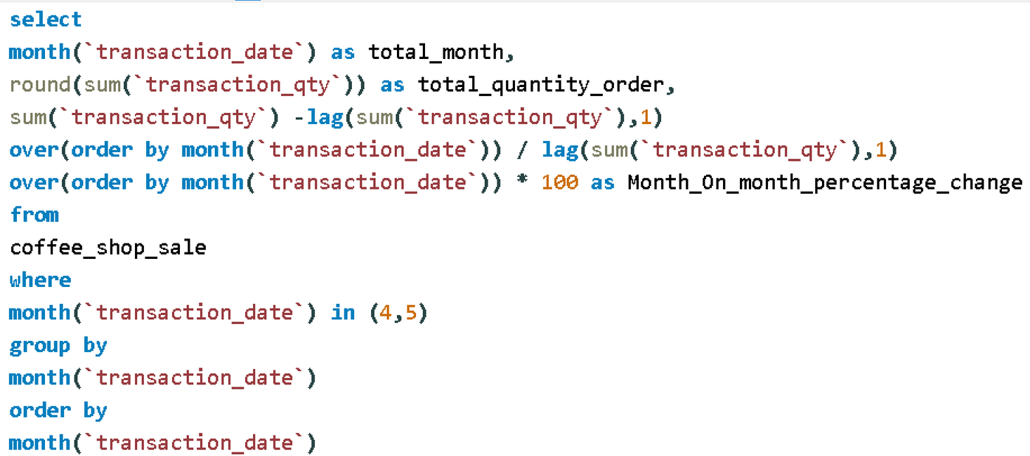
Hanover and Tyke
Determine month on month increase or decrease in total quantity sold

Slide 19
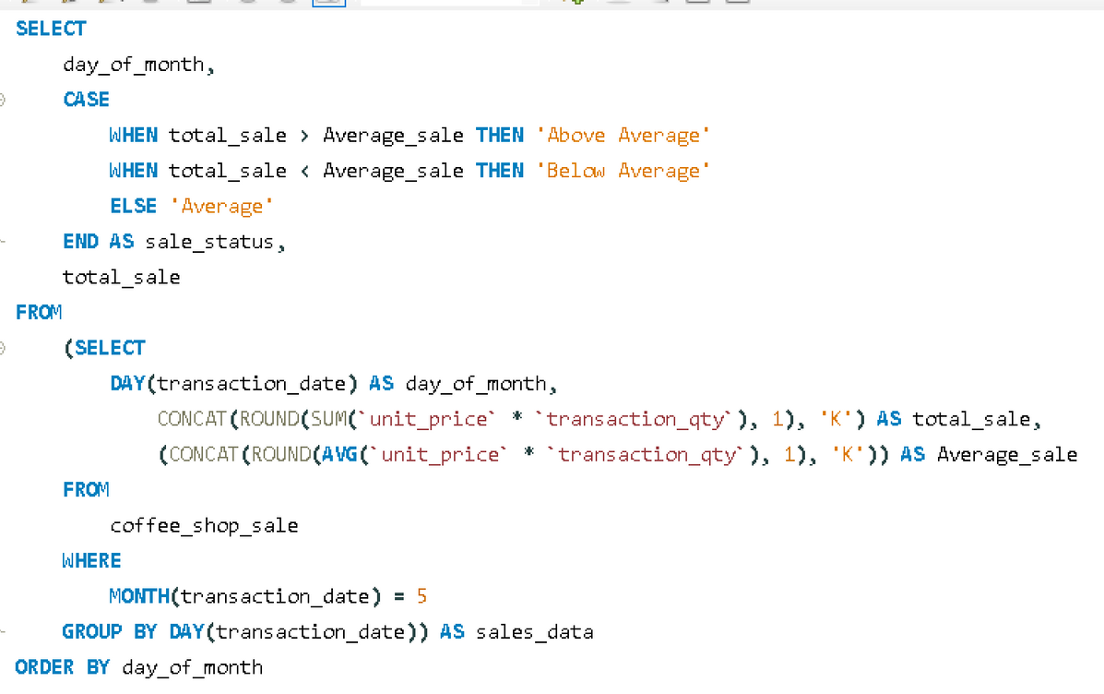
Hanover and Tyke
Compare each day of may month weather they are above average or below average

Slide 20
Hanover and Tyke
Requirement For Dashboard

Slide 21
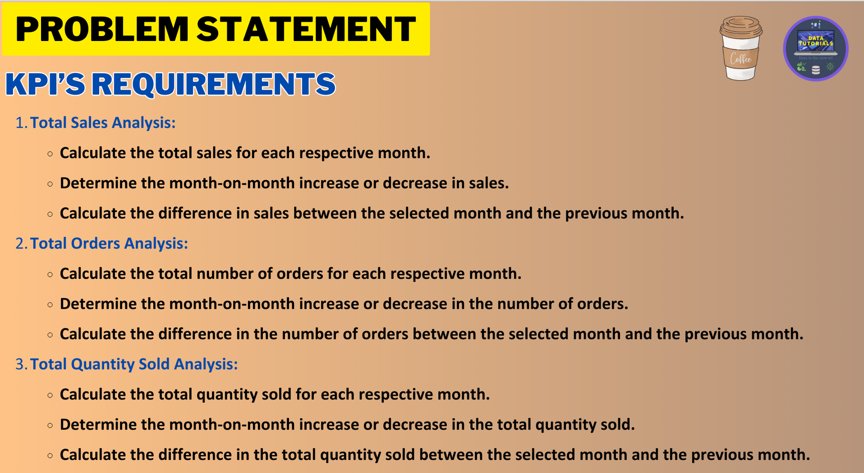

Slide 22
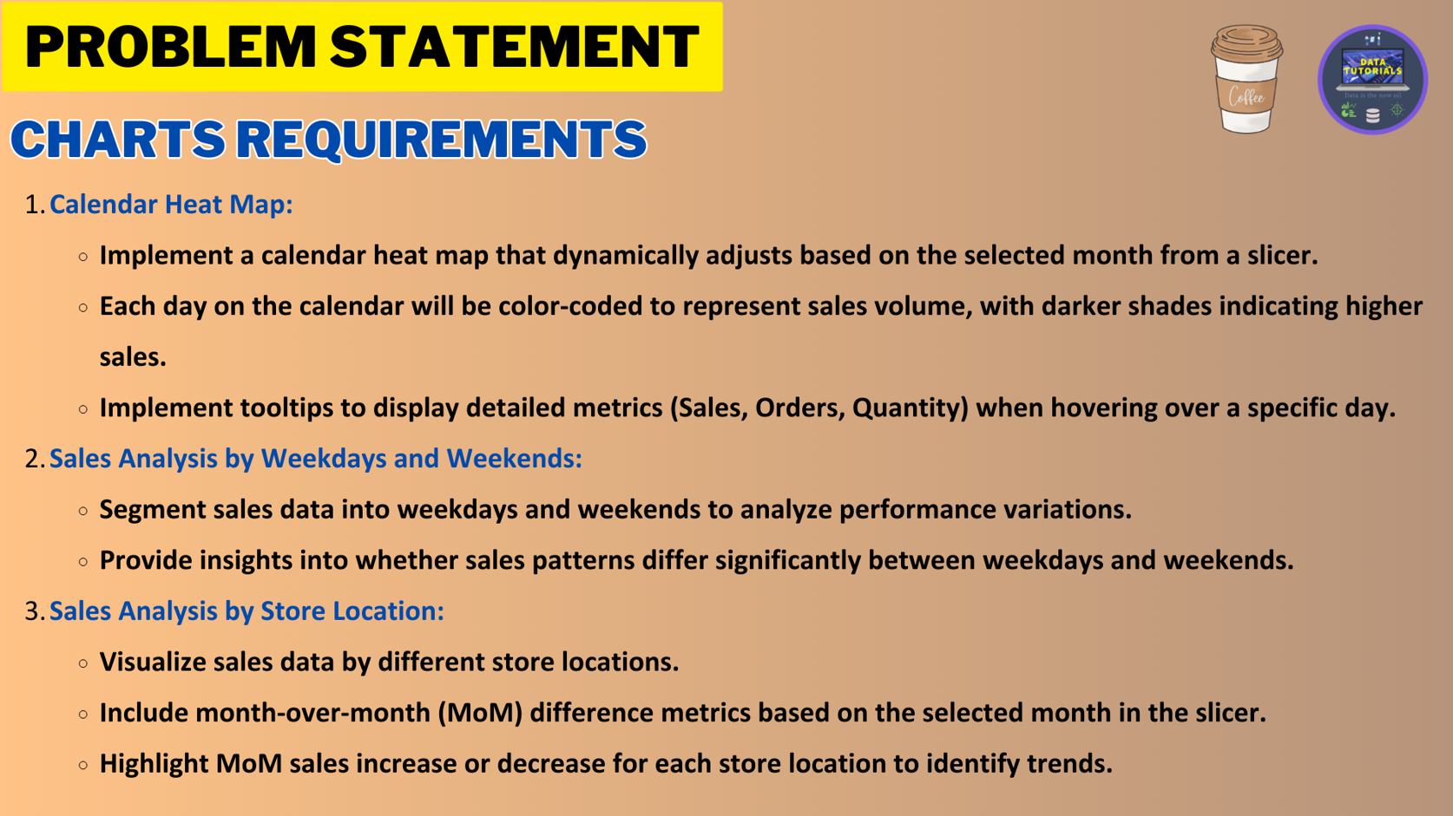

Slide 23
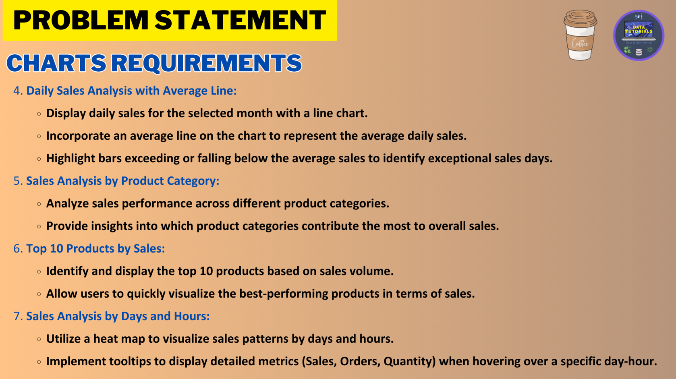

Slide 24
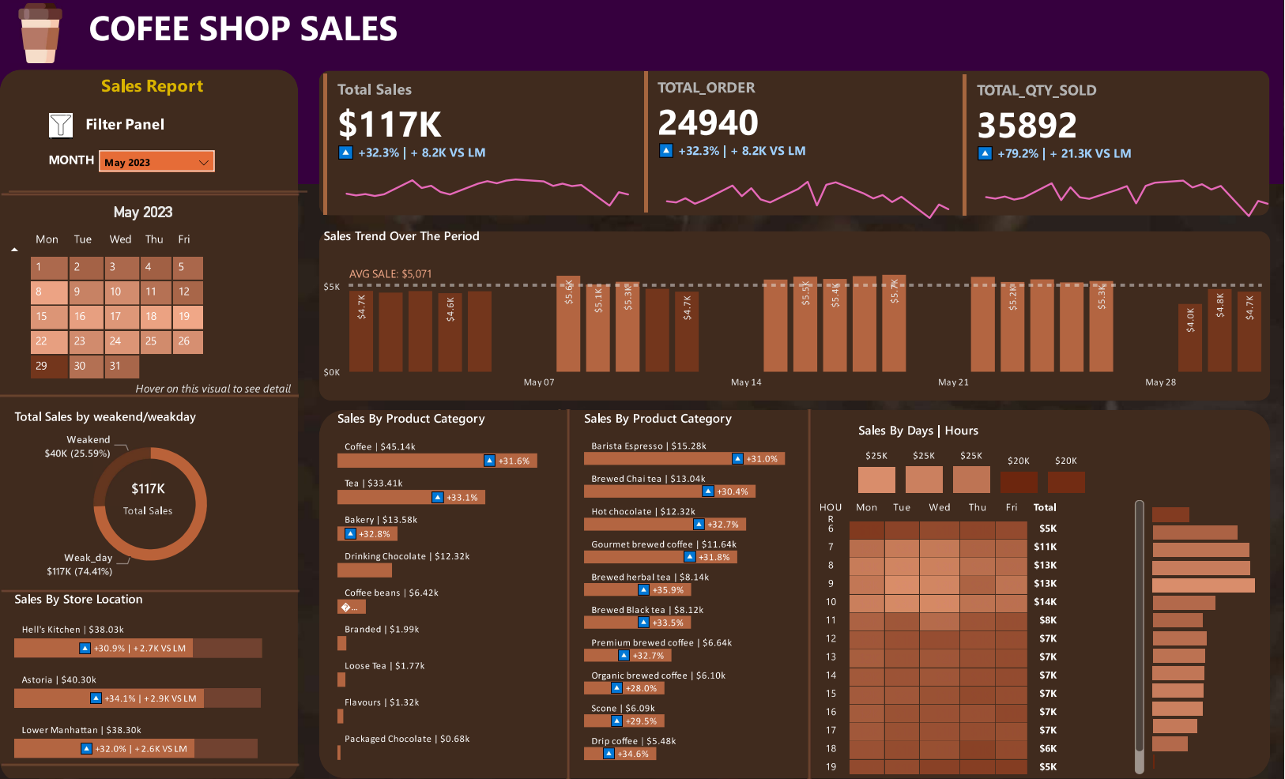

Slide 25



Hanover and Tyke
Thank You

